Slide 1
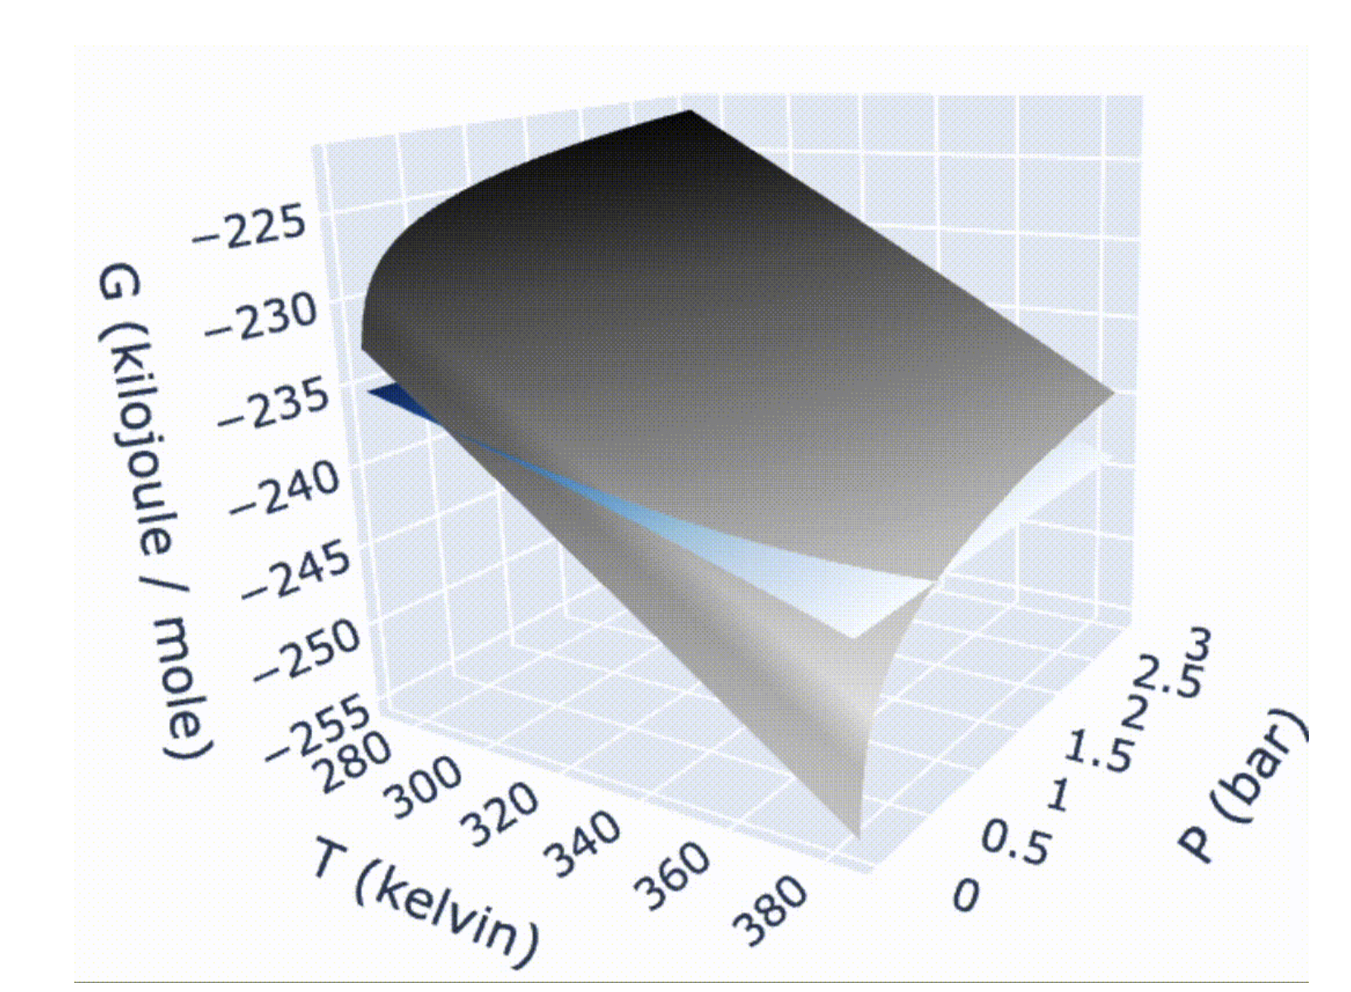

Today we’re going to talk about quantities like this
$$G(T,P)$$

Slide 2

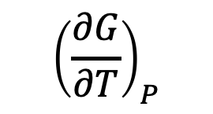
Today we’re going to talk about quantities like this
$${\left(\frac{∂G}{∂T}\right)}_{P}$$
Moving along an isobar
$$G(T,P)$$

Slide 3
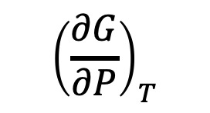
Today we’re going to talk about quantities like this
Moving along an isotherm
$${\left(\frac{∂G}{∂P}\right)}_{T}$$
$$G(T,P)$$

Slide 4
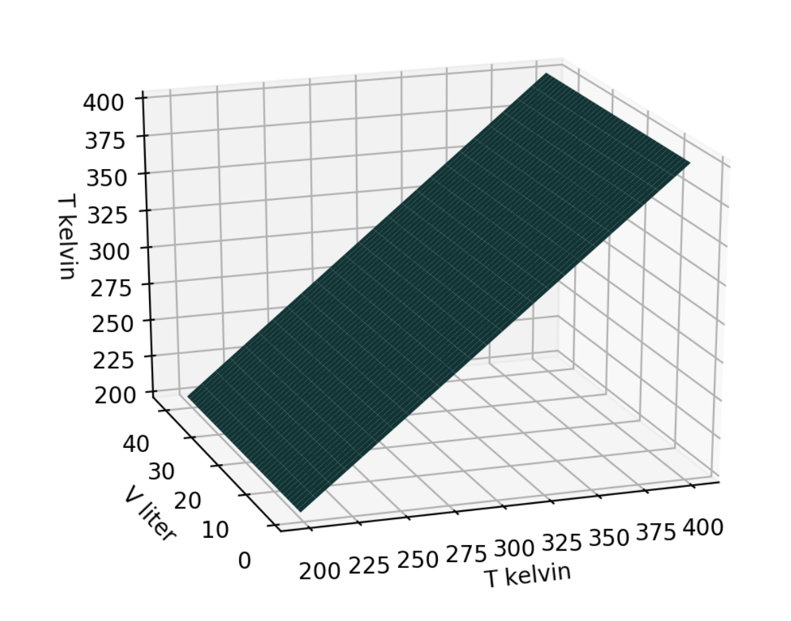
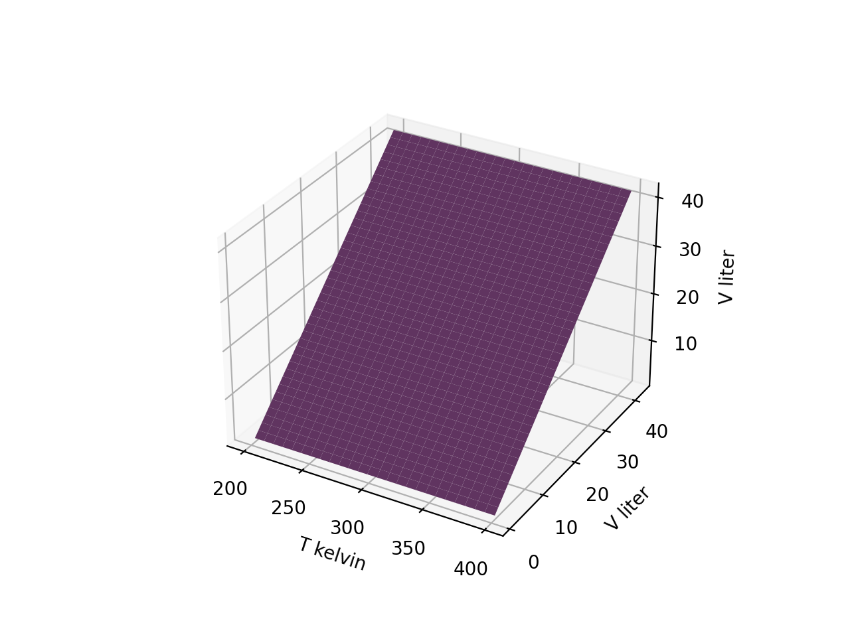


We’ll start with cases where the state function is one of the state space variables
$$T(T,V)$$
$$V(T,V)$$

Slide 5
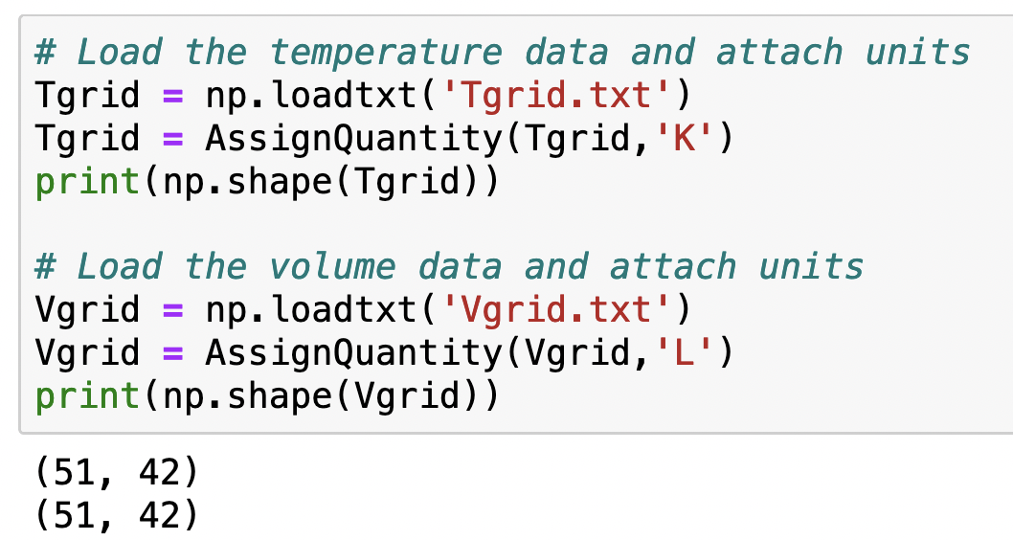
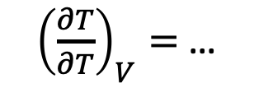
Tgrid: representation of the temperature part of state space
${\left(\frac{∂T}{∂T}\right)}_{V}=$ …
Moving along an isochore

Slide 6
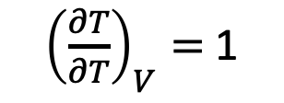
Tgrid: representation of the temperature part of state space
${\left(\frac{∂T}{∂T}\right)}_{V}=$ 1
Moving along an isochore

Slide 7
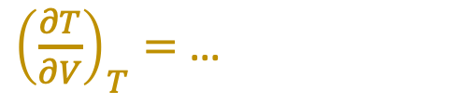
Tgrid: representation of the temperature part of state space
${\left(\frac{∂T}{∂V}\right)}_{T}=$ …
Moving along an isotherm

Slide 8
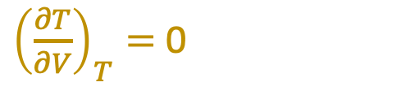
Tgrid: representation of the temperature part of state space
${\left(\frac{∂T}{∂V}\right)}_{T}=$ 0
Moving along an isotherm

Slide 9
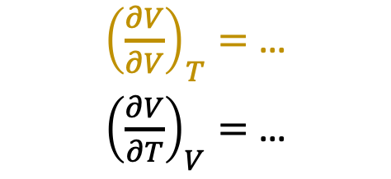
Vgrid: representation of the volume part of state space
${\left(\frac{∂V}{∂V}\right)}_{T}=$ …
${\left(\frac{∂V}{∂T}\right)}_{V}=$ …

Slide 10
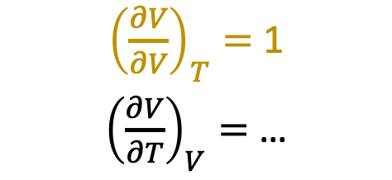
Vgrid: representation of the volume part of state space
${\left(\frac{∂V}{∂V}\right)}_{T}=$ 1
${\left(\frac{∂V}{∂T}\right)}_{V}=$ …

Slide 11
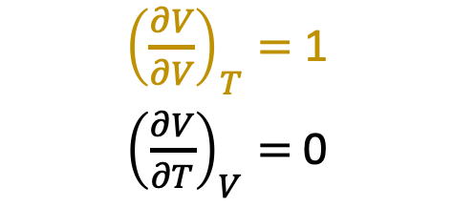
Vgrid: representation of the volume part of state space
${\left(\frac{∂V}{∂V}\right)}_{T}=$ 1
${\left(\frac{∂V}{∂T}\right)}_{V}=$ 0

Slide 12
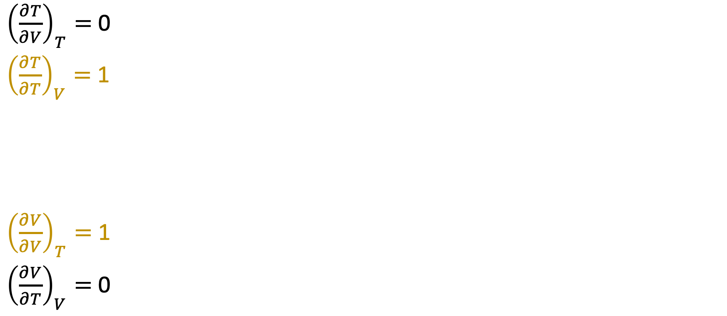
Summary
${\left(\frac{∂T}{∂V}\right)}_{T}=$ 0
${\left(\frac{∂T}{∂T}\right)}_{V}=$ 1
${\left(\frac{∂V}{∂V}\right)}_{T}=$ 1
${\left(\frac{∂V}{∂T}\right)}_{V}=$ 0

Slide 13
Indices in the grids allow us to refer to specific elements (scalars)
Tgrid[0,0]

Slide 14
Indices in the grids allow us to refer to specific elements (scalars)
Tgrid[-1,0]
Tgrid[0,0]

Slide 15
Indices in the grids allow us to refer to specific elements (scalars)
Tgrid[-1,0]
Tgrid[0,-1]
Tgrid[0,0]

Slide 16
Indices in the grids allow us to refer to specific elements (scalars)
Vgrid[0,0]

Slide 17
Indices in the grids allow us to refer to specific elements (scalars)
Vgrid[0,0]
Vgrid[-1,0]

Slide 18
Indices in the grids allow us to refer to specific elements (scalars)
Vgrid[0,-1]
Vgrid[-1,-1]
Vgrid[0,0]
Vgrid[-1,0]

Slide 19
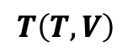
Isochores of Tgrid
$$T\left(T,V\right)$$
The elements of Tgrid belonging to a fixed volume form an array:
Tgrid[:,0] = 200, 204, … 400

Slide 20
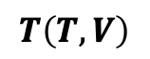
Isochores of Tgrid
$$T\left(T,V\right)$$
If we used any other volume, the result would be exactly the same
Tgrid[:,1] = 200, 204, … 400

Slide 21
Isochores of Tgrid
$$T\left(T,V\right)$$
If we used any other volume, the result would be exactly the same
Tgrid[:,-1] = 200, 204, … 400

Slide 22
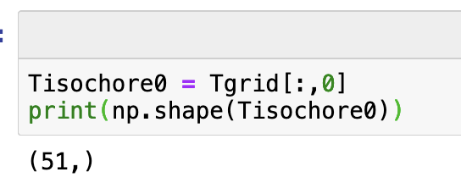
Isochores of Tgrid
$$T\left(T,V\right)$$
The elements of Tgrid belonging to a fixed volume is an array:
Tgrid[:,0] = 200, 204, … 400
Here’s how you’d create a variable that holds all these numbers. Notice that it has 51 elements, whose values run from 200 to 400 K.

Slide 23
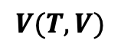
Isotherms of Vgrid
$$V(T,V)$$
The elements of Vgrid belonging to a certain temperature index is also an array:
Vgrid[0,:] = 1, 2, …

Slide 24
Isotherms of Vgrid
$$V(T,V)$$
The elements of Vgrid belonging to a certain temperature index is also an array:
Vgrid[1,:] = 1, 2, …

Slide 25
Isotherms of Vgrid
$$V(T,V)$$
The elements of Vgrid belonging to a certain temperature index is also an array:
Vgrid[-1,:] = 1, 2, …

Slide 26
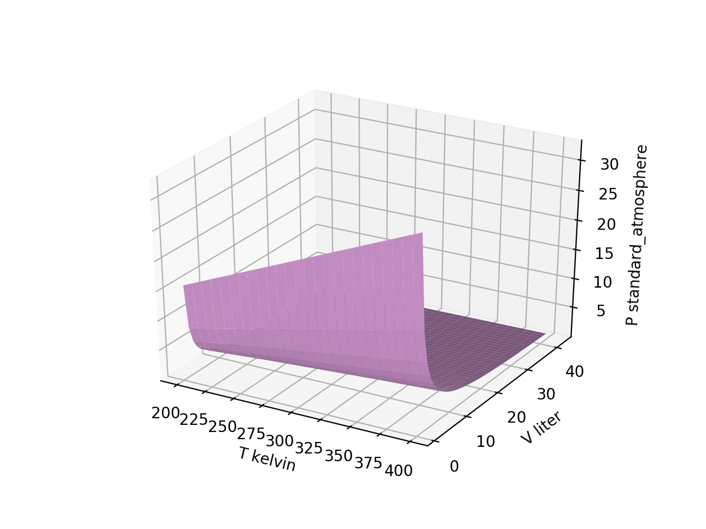
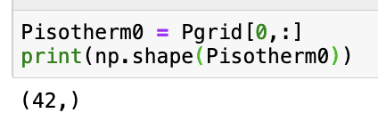
Isotherms of $P(T,V)$ (“Boyle isotherms”)

Slide 27

Isotherms of $P(T,V)$ (“Boyle isotherms”)

Slide 28
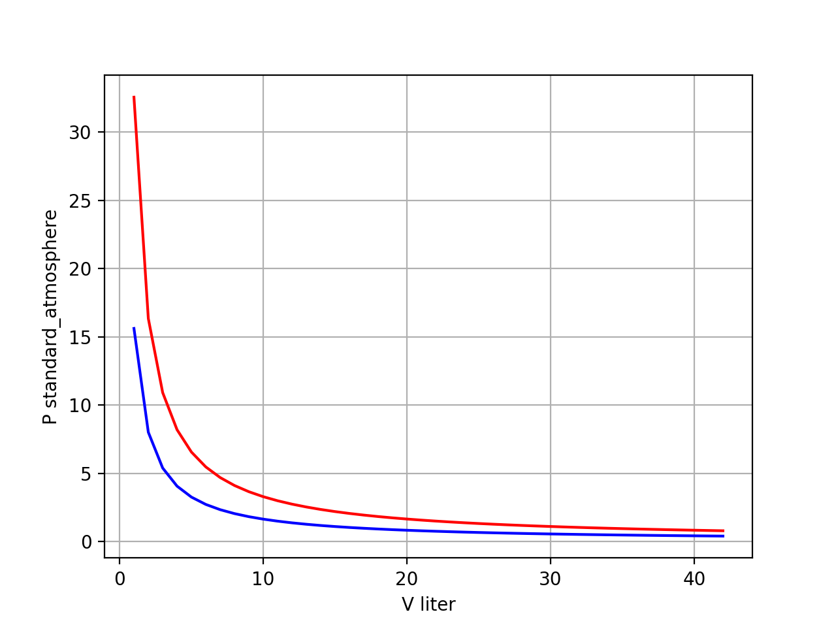
Isotherms of $P(T,V)$ (“Boyle isotherms”)
isotherms

Slide 29
Isotherms of $P(T,V)$ (“Boyle isotherms”)
isotherms
T = 400 K isotherm

Slide 30
Isotherms of $P(T,V)$ (“Boyle isotherms”)
isotherms
T = 400 K isotherm
T = 200 K isotherm

Slide 31
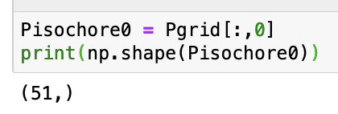
Isochores of $P(T,V)$

Slide 32
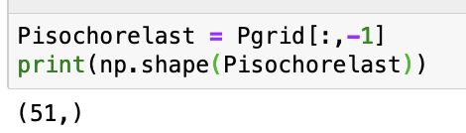
Isochores of $P(T,V)$

Slide 33
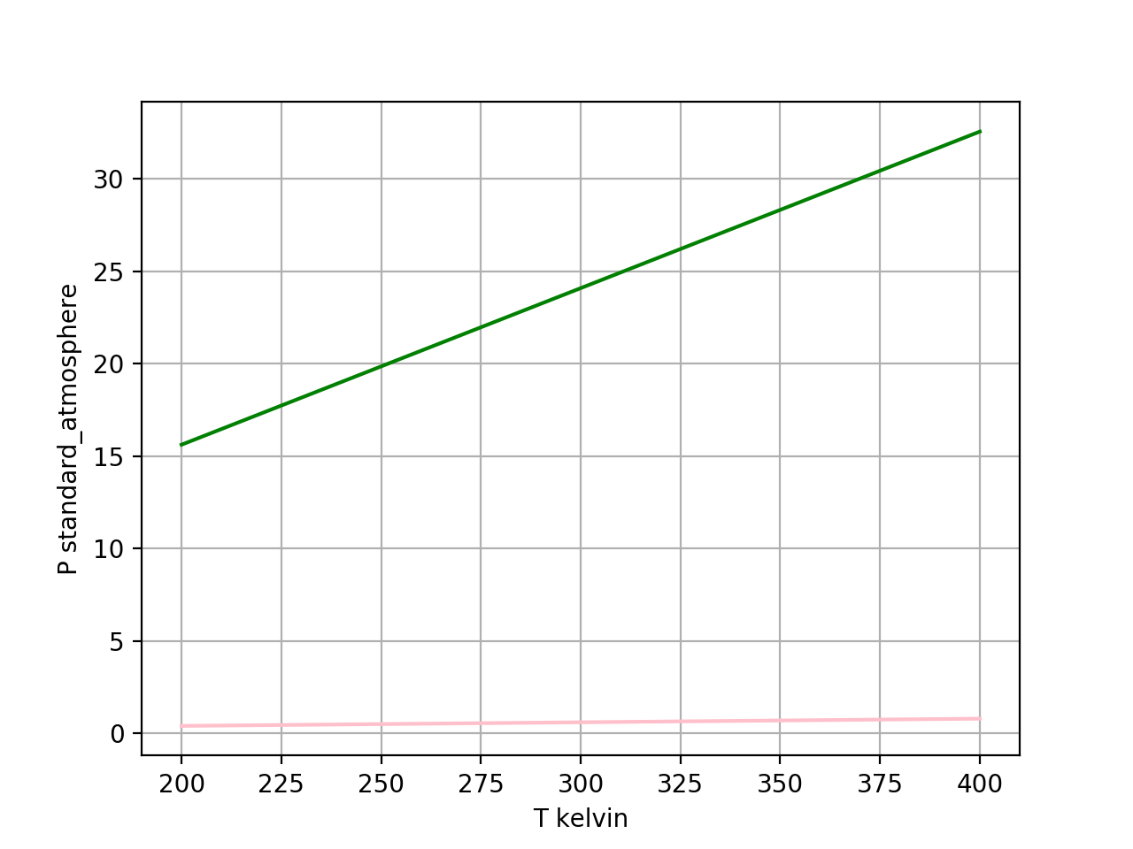
Isochores of $P(T,V)$
isochores

Slide 34
Isochores of $P(T,V)$
V = 1-Liter isochore
isochores

Slide 35
Isochores of $P(T,V)$
V = 1-Liter isochore
isochores
V = 42-Liter isochore

Slide 36
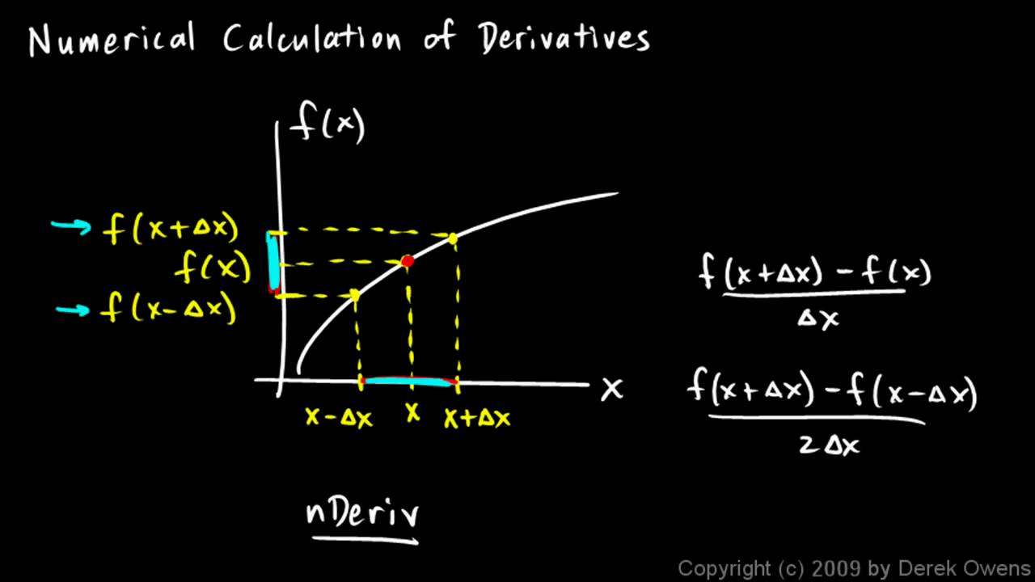
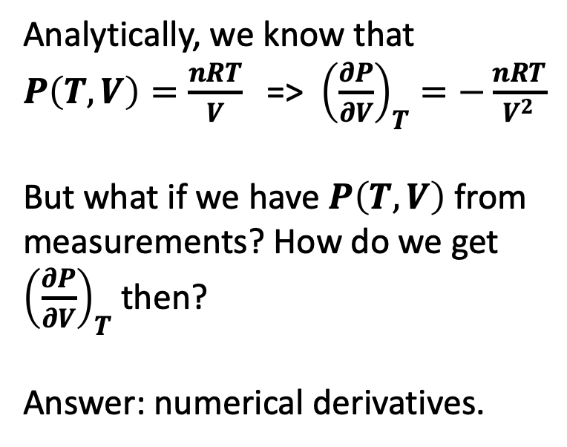
Numerical derivatives
Analytically, we know that $P\left(T,V\right)=\frac{nRT}{V}$ => ${\left(\frac{∂P}{∂V}\right)}_{T}=−\frac{nRT}{V^{2}}$
But what if we have $P\left(T,V\right)$ from measurements? How do we get ${\left(\frac{∂P}{∂V}\right)}_{T}$ then?
Answer: numerical derivatives.
https://i.ytimg.com/vi/oi2mrzVu0AE/maxresdefault.jpg

Slide 37


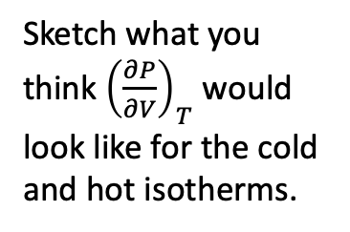
Numerical derivatives of Boyle isotherms
$P(V)$
Sketch what you think ${\left(\frac{∂P}{∂V}\right)}_{T}$ would look like for the cold and hot isotherms.
$${\left(\frac{∂P}{∂V}\right)}_{T}$$

Slide 38
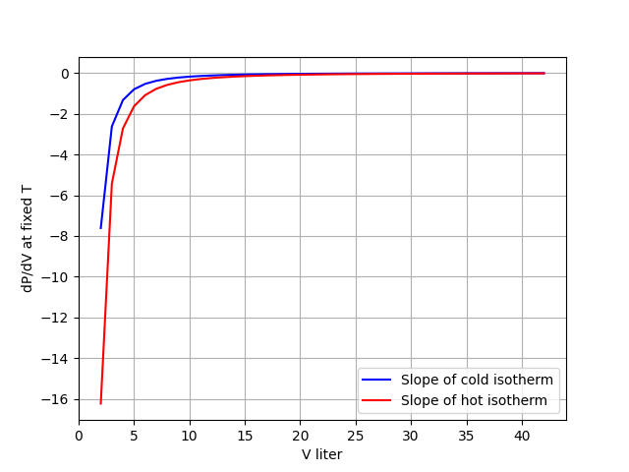
Numerical derivatives of Boyle isotherms
$P(V)$
$${\left(\frac{∂P}{∂V}\right)}_{T}$$

Slide 39
